Slide 1

Java + Mobile course by Enered

Slide 2
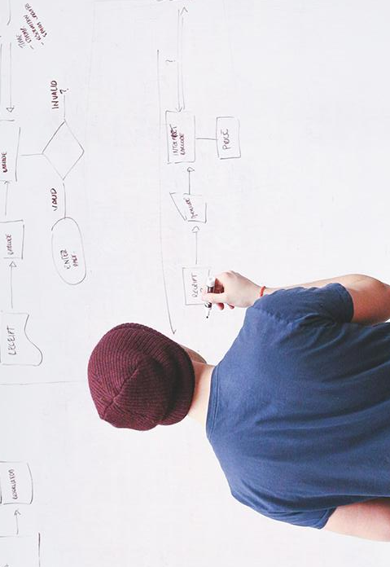
HELLO!
I am Vlad Butnaru
I will be your trainer for Java sessions!
PS: It’ll be awesome!

Slide 3
6+ years in IT
83 projects
6 projects
That’s a lot of cups of coffee
And a lot nerves
Were personal

Slide 4
16 years old
17 years old
18 years old
The age I started programming
The age I had my first real job
First job at a corporation (I hated every second of it)

Slide 5
1.
Course organization
Let’s start with the real deal

Slide 6
Basic rules
We are equal, so no “Sir” or “Mister”, please! We are all passionate about what we do here.
You will become professionals, I will do everything I can do make that possible!
THE EMBLEM SYSTEM
You will be given emblems throughout the course.
Some emblems will expire in 7 days, other will last all course long. I encourage you to gather as many as possible since there is a high chance of getting a job ☺
THE TESTS
I will test your skills and knowledge every now an then.
Tests will be quick, to the point and will give me a general idea of what you actually understand.
THE FEEDBACK
It is essential for me to know where I have to improve, so be sincere and fair!
Consider it a gift for me, I love gifts!
THE COMMUNICATION
We have so many channles, please use them! We can talk by the phone, on facebook, on moodle, on skype or anywhere you want!

Slide 7
Useful links
https://github.com/vladutbutnaru/enered-java
http://online.enered.org
https://www.eclipse.org/downloads/
http://www.oracle.com/technetwork/java/javase/downloads/index.html
http://goo.gl/forms/ARBqgoCk5C
.

Slide 8
THE PROJECT
You will team up and create an amazing project using your skills and collaboration

Slide 9
Do’s and don’ts
DO
Help others if in need
Ask questions
Come up with brilliant solutions
Correct mistakes
Be proactive
Be a good teammate
DON’T
Be arrogant
Disrespect others
Make stupid jokes
Interrupt others
SKIP CLASSES
Damage any goods
Be afraid to ask questions

Slide 10
2.
Let’s get to know each other
Who are you? What do you want to achieve?

Slide 11
Java developer
Java automated tester
Java System Architect
“One of the most beautiful qualities of true friendship is to understand and to be understood”
Java Guru
Java Freelancer
Java Consultant

Slide 12
Break ☺

Slide 13
3.
What is this Java thing?
No, really, what is it?

Slide 14
Well…
Java was originally designed for interactive TV
2nd most popular programming language (after the hidious C)
It runs on almost all devices
It is powering 95% of all Enterprise apps
Pretty interesting, huh?

Slide 15
There are 2 major directions
Java SE (Standard Edition)
This version is used mainly for desktop applications, that run for a small number of clients. It’s features allow you to create a modern application that runs on any operating system.
Java EE (Enterprise edition)
This version is used mainly for web applications. There is a server that serves the Java app to a big number of clients simultainiously. To date, it is the most used programming language for enterprise solutions.

Slide 16
60,000,000+
Applications & libraries built using Java technologies

Slide 17
400 euro
20+
50+
The minimum salary of a Junior Java Developer
Companies in Iasi that have Java departments
Java-related jobs monthly

Slide 18
~4 months
1.5+ years
3+ years
The time it takes to pass a Junior interview
The time until you can reach Medior level
The time until you can reach Senior level

Slide 19

Does that motivate you?
I REALLY HOPE SO

Slide 20
I receive ~3 job requests weekly
…and I am not the only one complaining

Slide 21
International standard
You

Slide 22
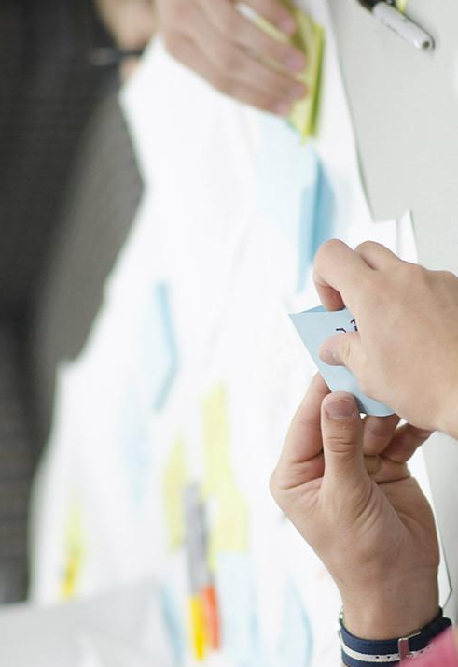
One language for all businesses
Java technologies are so complex, that is the perfect solution for building small to huge applications for any purprose.

Slide 23
Main JAVA Advantages
Object Oriented
Everything is an Object
Platform independent
Java <3 JVM
Secure
End-to-end encryption
Architectural-neutral
Unlimited power
Portable
Embedded/Mobile
Robust
More runtime, less exceptions
Multithreaded
Even more power
Distributed
Parallel execution
Fun
Fun to learn, fun to develop

Slide 24
Home setup
JDK http://www.oracle.com/technetwork/java/javase/downloads/jdk8-downloads-2133151.html
Eclipse http://www.eclipse.org/downloads/packages/eclipse-ide-java-developers/mars2
Works on Windows/Mac OSX/Linux
Respect the order, please!

Slide 25
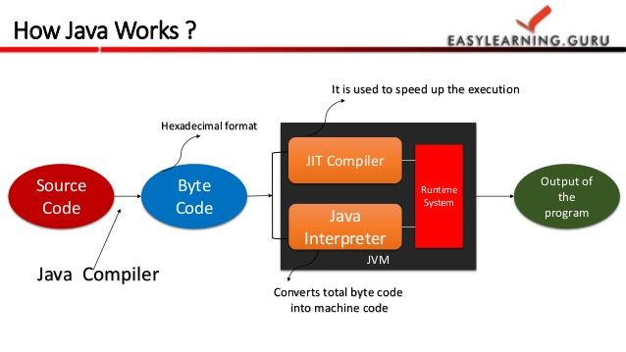
Java Execution Scheme

Slide 26
Break ☺

Slide 27
4.
Introduction to programming (I)
Flow controls are all over the place!

Slide 28
Programming essentials
The computer knows nothing!
Everything our app does is data processing
Programs solve problems through a process
We are memory and processing power dependent
We are also dependent on syntax and vocabulary
You should NEVER reinvent the wheel

Slide 29
Flow controls…
Input
Data
Variables
Processing
Algorithms
Processes
Output
Processed data

Slide 30
We have THIS, we want THAT by doing THIS.

Slide 31
The Java Syntax
Primitive types (int, double, char, String, etc.)
Objects (User, Product, Transaction, etc.)
Methods (add(),multiply(),login(), etc.)
Classes (blueprint of objects)

Slide 32
Primitive types

Slide 33
Methods

Slide 34
Classes

Slide 35
Objects

Slide 36
Example
I have 2 numbers, I want 1 number by adding them together.

Slide 37
Example
I have 2 bank account balances, I want 1 number by substraction.

Slide 38
Example
I have the length of a triangle base and height, I want 1 number by calculating the area.

Slide 39
ECLIPSE HANDS ON
Please implement these examples in Java, using Eclipse IDE

Slide 40
Break ☺

Slide 41
5.
Github DEMO
You will find the presentations, assignments and resources there

Slide 42
6.
Ending notes
What have you done today?

Slide 43
Session review
You met me ☺
I met you ☺
You know what Java is and how many opportunities it comes with
You understand flow controls
You know the Java basic syntax
You’ve built your first Java app! Good job!

Slide 44
THANKS!
Any questions?
You can find me at:
@web: http://vladbutnaru.com/
@facebook· Vladut Butnaru
@linkedin· Vlad Butnaru
@email : vlad2me@gmail.com
@phone : +40 0754 827 620

Slide 45
Feedback please!
http://bit.do/feedbackvlad

